Slide 1
Lego Pill Sorter
Group Members: Nicola DaSilva, Jacob Hazelbaker, Natacha Barcala

Slide 2
Objective
The objective of this project is to build a robot that assists in sorting pills for those:
with a busy schedule
any individual that may be color blind
anyone who may have difficulties sorting pills
for anyone that just likes robots or Legos in general
The outcome of this color sorting technique will be visible in a mini pill organizer.

Slide 3
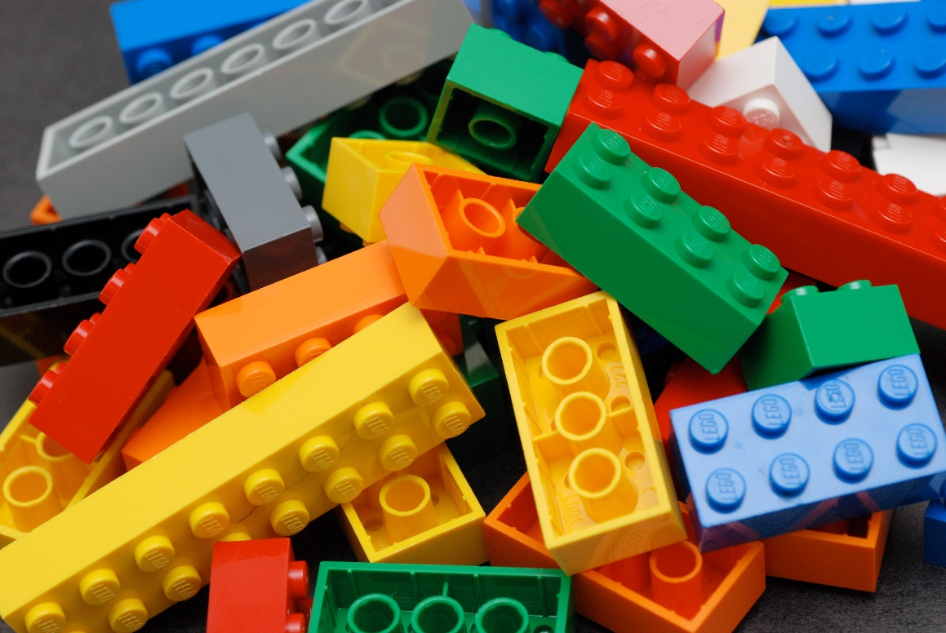
Parts List
Legos and Lego tape
Colored M&M’s and Tic Tac
Raspberry Pi
Webcam
Servos
Battery Pack

Slide 4
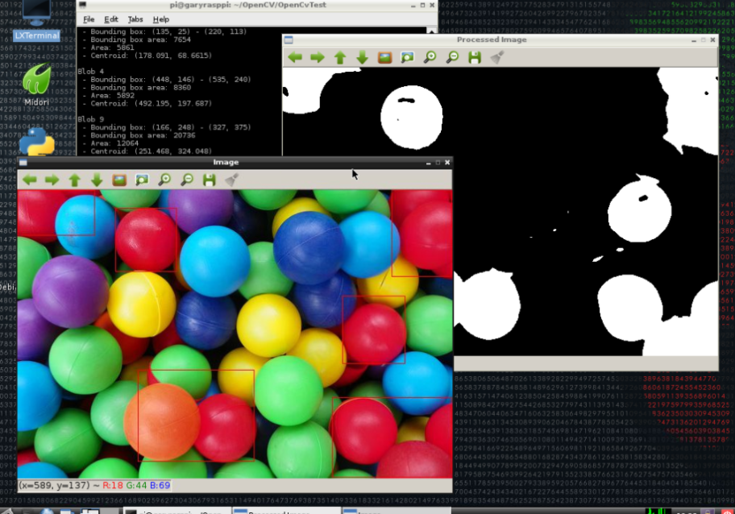
Software Used
Python
OpenCV
Raspbian
SRC: https://programmaticponderings.com/2013/02/09/opencv-and-cvblob-with-raspberry-pi/

Slide 5
Techniques Used
Pills are fed through the ramp and spotted by the webcam before they go to their designated areas.
OpenCV Color Detection technique was used to program the Logitech webcam to see which pill is required.
The servo at the bottom of the ramp waits for the instructions from the webcam and OpenCV code.
Once the specific pill is seen, the servo moves it to the right bin.

Slide 6
Video Demonstration
Link: https://www.youtube.com/watch?v=2oY3lIN6V7k&feature=youtu.be

Slide 7
End

